Slide 1
Contesting on VHF and Above
Jim Lommen KC7QY
Socorro, NM (DM64)

Slide 2
Outline
Why contest
VHF Awards (VUCC, WAS, DXCC, etc.)
Major VHF+ Contests
Entry level contest categories (Single band, 3 Band, FM Only, All Band, Rover)
Contest logging: software, Cabrillo logs, log submission, the Robot, Log checking report
Contest operating tips

Slide 3
Why Contest?
Improve operating skill
Learn about propagation
Improve your station
Work toward awards
Have FUN!!!

Slide 4
Major VHF and Above Contests
ARRL VHF – June, January, and September
CQ WW VHF – July 6M & 2M Only
ARRL 222 and Up – August (note: distance scoring uses 6 figure grids)
10GHz and Up – August and September (two weekends, combined score)
ARRL EME – September – November (three weekends, bands vary by date)
Central States VHF Spring Sprints – April and May (most are 4 hours, single band)
SMIRK 6 Meter Contest - July

Slide 5
VHF+ Awards
Just Like HF; WAS, DXCC, WAC
VUCC – VHF/UHF Century Club (Confirm 100 grids on 6M or 2M; fewer on higher bands)
Fred Fish Memorial Award, FFMA – 6M, confirm all 488 grids in the continental US
2M WA(48)S via terrestrial modes.

Slide 6
Contest Objective
Work as many other stations as you can (Qs)
Work as many Multipliers as possible (Mults)

Slide 7
Contest Scoring
In general
QSOs X Points X Multipliers
Example;
100 Qs worth 1 points = 100
25 Qs worth 2 points = 50
5 Qs worth 3 points = 15
Multipliers = 60 Grids
Score = (100 + 50 + 15) x 60 = 9,900

Slide 8
Contest Basics
Read the rules
Know the contest exchange
Set up your logging software (in advance)
Log in UTC!!!
More BIC time = higher score
Review and score your log (accuracy counts)
Submit the Cabrillo log to the sponsors – no log is too small

Slide 9
Basic Entry Levels for Single Operator
Single Band
All Band
3 Band (50, 144, 432MHz; low power)
FM Only
Portable (typically QRP)
Rover (anyone that operates from more than one grid)

Slide 10
Assistance
Different from HF contests but varies by sponsor
You may self spot on DX-alerting nets, chatrooms, etc. (limited for CQ VHF)
Rovers can use APRS tracking
Repeater spotting allowed for ARRL contests
Use of FM “national calling” frequencies allowed (by ARRL, not for CQ but other simplex frequencies OK)

Slide 11
Contest Logging Software
N1MM+
N3FJP – VHF Log
W3KM – VHFLOG and KMRoverlog
N1MU – RoverLog
You can still paper log!

Slide 12
Paper Log Submission

Slide 13
Cabrillo Log

Slide 14
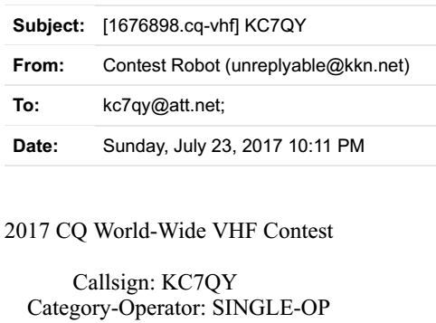
Log Submission
E-mail Cabrillo file (your call.log) to Contest Sponsor or use their app.
Get help from your local club if having difficulties
Robot will confirm log acceptance or note issues

Slide 15
Contesting Tips
BIC, can’t say that too often
Be loud on 2M
Listen for the weak ones
Be patient when signals fade, wait and they will come back
Follow the rovers, get all the mults you can and help them out
Rovers will often ask you to move up the bands with them – DO IT!
Check the CW portion of the band, extends your range and can add mults
Add digital modes
Upgrade your station. You can add dB relatively inexpensively at VHF/UHF

Slide 16
Contesting Tips - continued
Log dupes, don’t waste time discussing. Move on to the next QSO.
Check your Cabrillo logs for obvious errors
Study your log checking reports when they are posted. See what you need to improve on.
Read the soapbox comments. See what you might have missed. Glean tips.
Put your logs up on LoTW – please!

